Slide 1
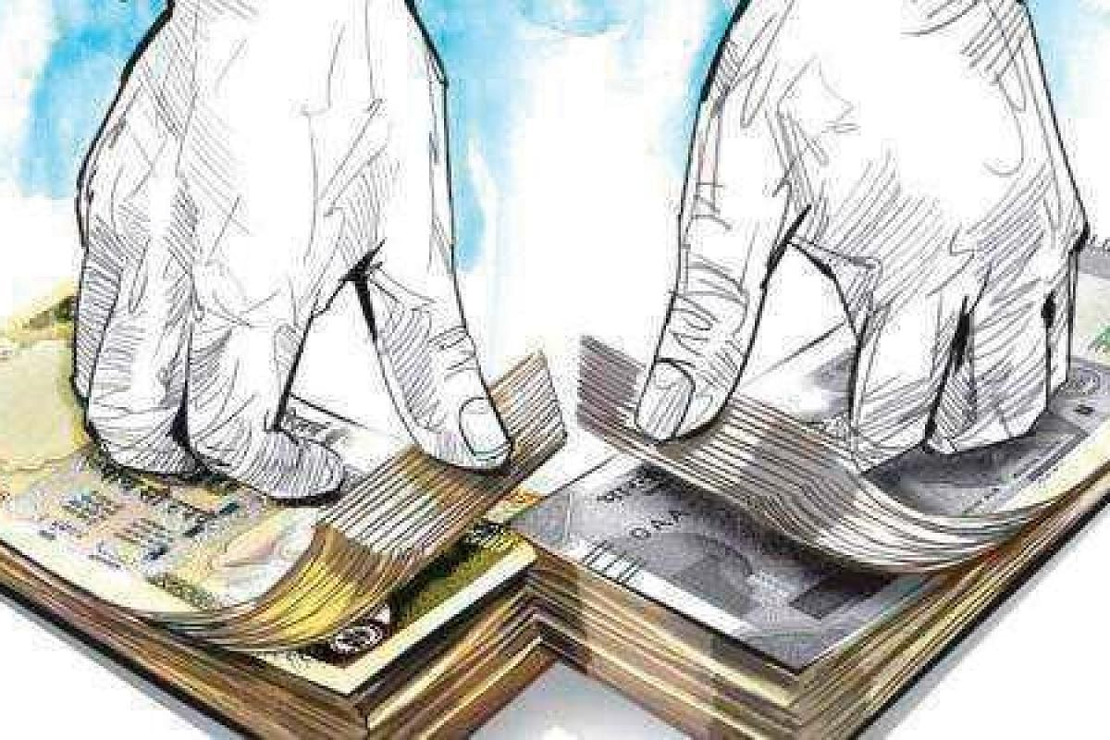
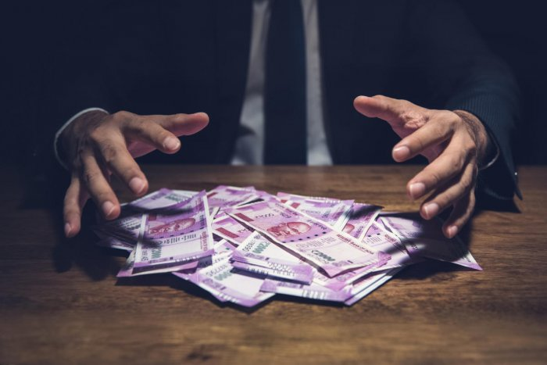

Major Project
TOPIC:
Bank Loan Fraud Detection Using ML

Slide 2
INTRODUCTION
I proudly present to you My Project Brief Summary . A summarized overview of the full and final plan can be easily presented to you by Me. This project designed exclusively
by RUDRA PRATAP SINGH.
Supervisor : Ms. Neelam Rawat

Slide 3
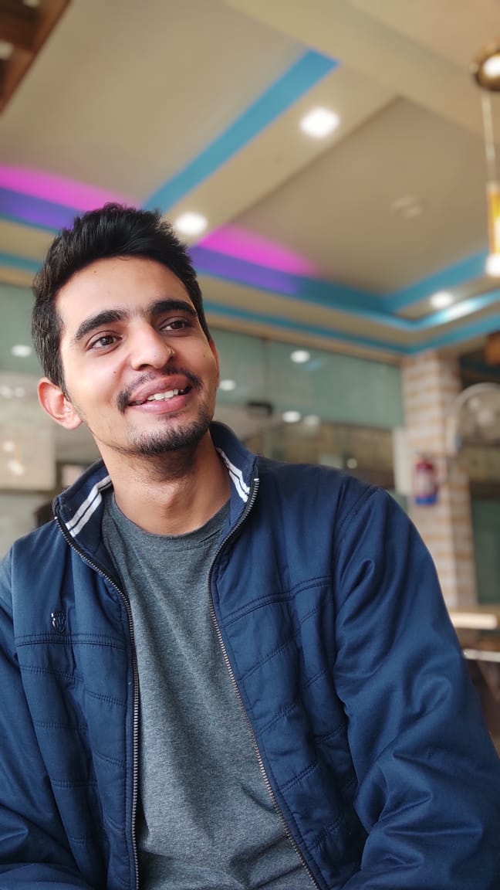
Team Presentation
RUDRA PRATAP SINGH MCA
(2 YEAR/5 SEM)
2000290140107
KIET GROUP OF INSTITUTION

Slide 4

IDEA Overview
When someone borrows some money from someone or some organization, in financial term it is known as loan .Distribution of the loans is the core business part of almost every banks. The main portion the bank’s assets Is directly came from the profit earned from the loans distributed by the banks. The prime objective in banking environment is to invest their assets in safe hands where it is. Today many banks/financial companies approves loan after a regress process of verification and validation but still there is no surety whether the chosen applicant is the deserving right applicant out of all applicants. Through this system we can predict whether that particular applicant is safe or not and the whole process of validation of features is automated by machine learning technique. The disadvantage of this model is that it emphasizes different weights to each factor but in real life sometime loan can be approved on the basis of single strong factor only, which is not possible through this system.
“save lives with the help of social media"

Slide 5

Project Goal
Y
The objective of the problem is to pick out which customer will be able to pay the debt and which customer is likely will not be able to pay the debts. Clearly we have to create a classification model here. We have to use algorithms like logistic regression, decision tree or random forest. We need to create a model that is accurate and the error percentage should be less. The main objective of this project is to predict whether assigning the loan to particular person will be safe or not. ... In this paper we are predict the loan data by using some machine learning algorithms they are classification, logic regression, Decision Tree and gradient boosting.
A classification model is run on data attempting to classify whether the person or client is eligible for get loan from any bank with good accuracy of statement.
Our objectives included some points about this Loan Status Prediction
WHY?

Slide 6

WHY DO WE NEED THIS SYSTEM?
Y
Get the Assets Safe.
To know that our Loan Applicant is safe for loan or not.
Time and Cost Saving.
WHY?

Slide 7
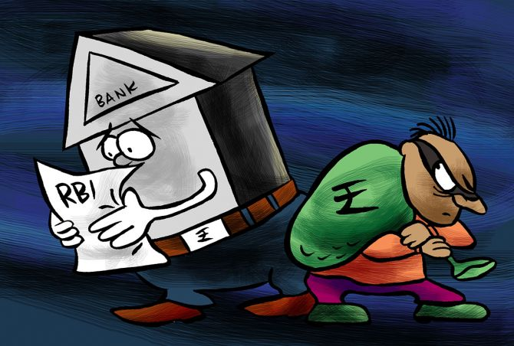
How Dangerous it can be?
Y
ABG Shipyard Ltd. company cheats SBI, 27 banks of over Rs 22,842 crore.
In financial year 2021, the Reserve Bank of India (RBI) reported bank frauds amounting to 1.38 trillion Indian rupees.
This was a decrease from over 1.85 trillion rupees in 2020.
News Reports

Slide 8
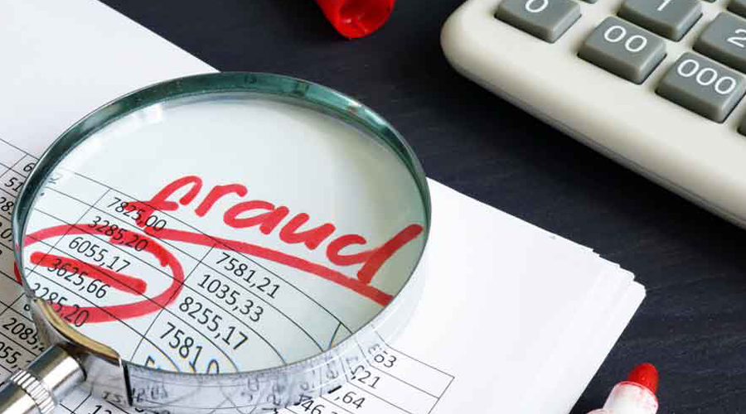
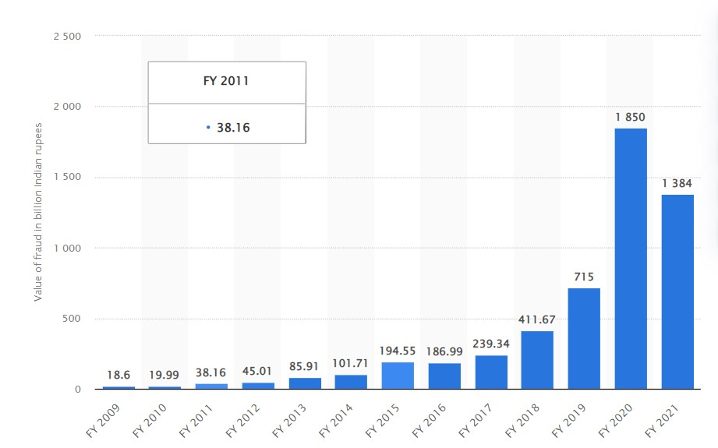
Stats
WHY?

Slide 9
FEATURES OF THE PROJECT
EASY TO USE
TIME SAVING
MONEY SAVING
COST EFFICIENT

Slide 10
HOW THE PROJECT WORK
Collection of Data
Choose a Model
Evaluate the Model
&
Parameter Tuning
1
3
5
2
4
6
Data Preparation
Train the Model
Make Predictions

Slide 11

TECHNOLOGY USED
IDE: VS Code, Anaconda
Programming Language: Python, ML Algos
Web Application: streamlit
Datasets : Google Dataset Search or Kaggle

Slide 12

Future Scope
This model can be used to compare various machine learning algorithm generated prediction models.
The model which will give higher accuracy will be chosen as the prediction model.
The Whole process will get automated from application to approval.

Slide 13
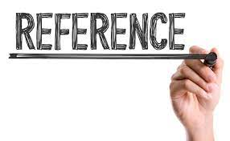

Bank Loan Prediction System using Machine Learning
Loan Approval Prediction using Machine Learning Algorithms Approach
Bank Loan Default Prediction with Machine Learning

Slide 14
TIME FRAME (ESTIMATED)
Duration of project: 2 month=60 days
Analysis & Design duration= 30% of 60 days =16 days
Implementation: 50% of 60 days= 30 days
Testing & Debugging: 15% of 60 days = 10days
Extra reserve time : 5% of 60 days = 4 days
Total working hour: 56 * 4(Days *per day working hour)=224 Hours

Slide 15
THANKYOU!!
QUERIES ARE WELCOMED

